Slide 1
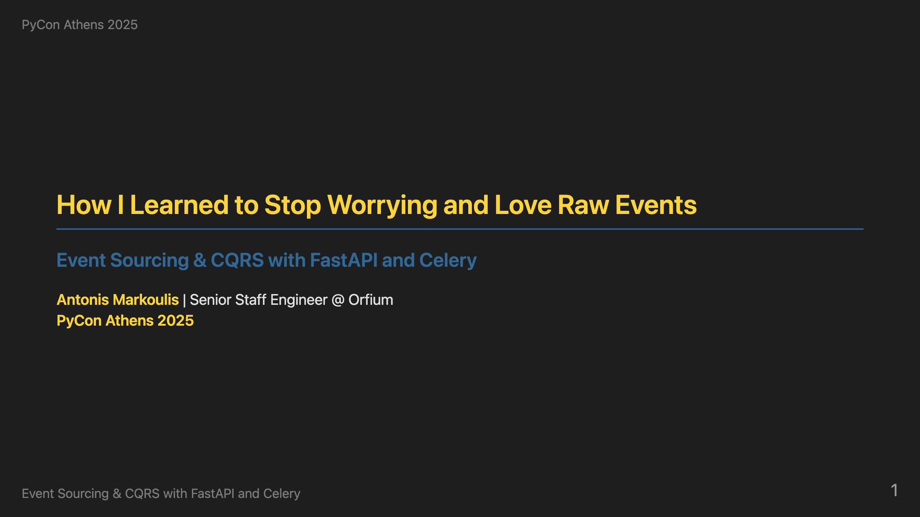
Notes:
Hello everybody! I'm super excited to be presenting at PyCon Athens. This is the first PyCon in Greece, so it's truly an honor to be part of this inaugural event. I'm Antonis Markoulis, Senior Staff Engineer at Orfium, where I work with multiple teams and am responsible for technical growth and software quality across the organization. I've been coding in Python for over 10 years, and I love solving complex distributed systems problems. Today I want to share with you how we solved a real production nightmare using event sourcing and CQRS with familiar Python tools like FastAPI and Celery. Let me start with the problem that led us to this solution.

Slide 2
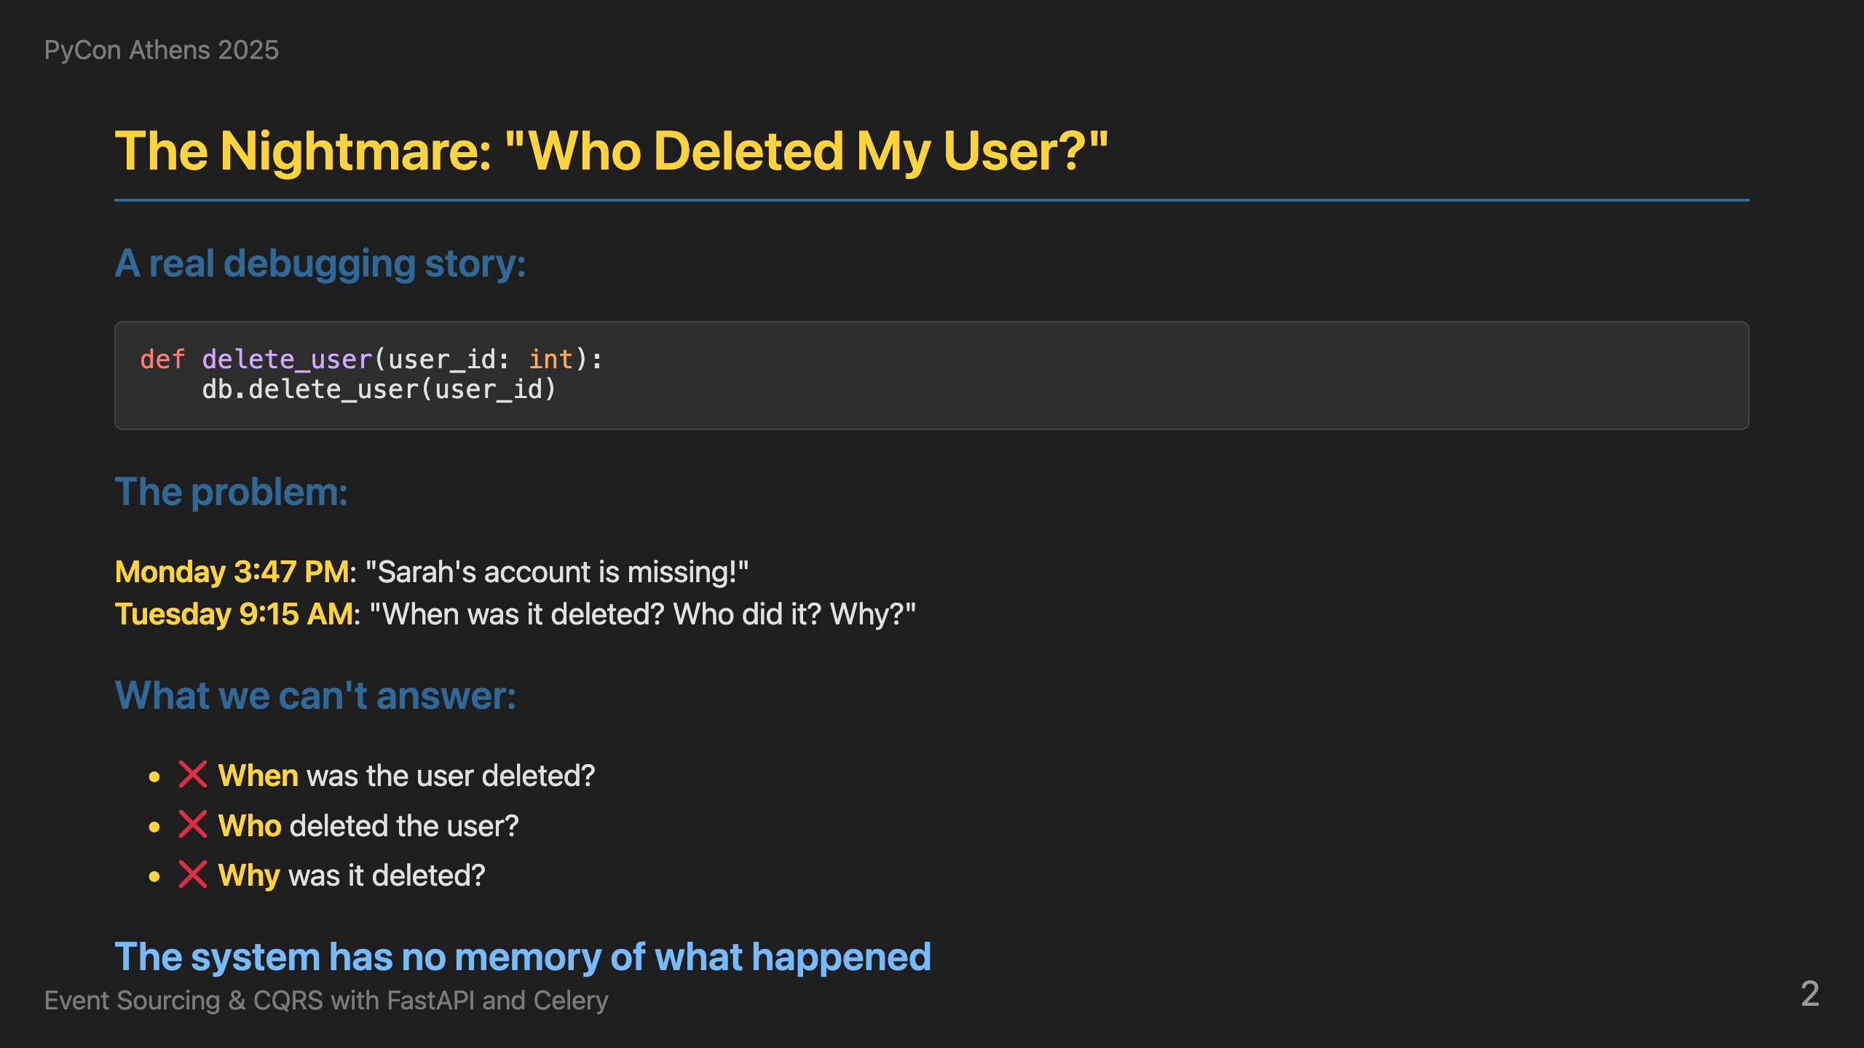
Notes:
This is a story that probably sounds familiar to many of you. Monday 3:47 PM - someone reports that Sarah's account is missing. Tuesday 9:15 AM - we're still trying to figure out when it was deleted, who did it, and why. With traditional systems, we can't answer any of these questions. Why is that? Usually we have one row per entity in our relational database and we update on top of it. In the case of hard delete, we lose the entry completely. If we have soft delete, we know when it was deleted using deleted_at, maybe who using updated_by, but in most cases we miss the reason or the different states the user was in. The system has no memory of what happened. This is the nightmare we all face when debugging production issues with classic architectures. This is exactly the problem that event sourcing solves - by storing every change as an immutable event, we can answer all these questions.

Slide 3
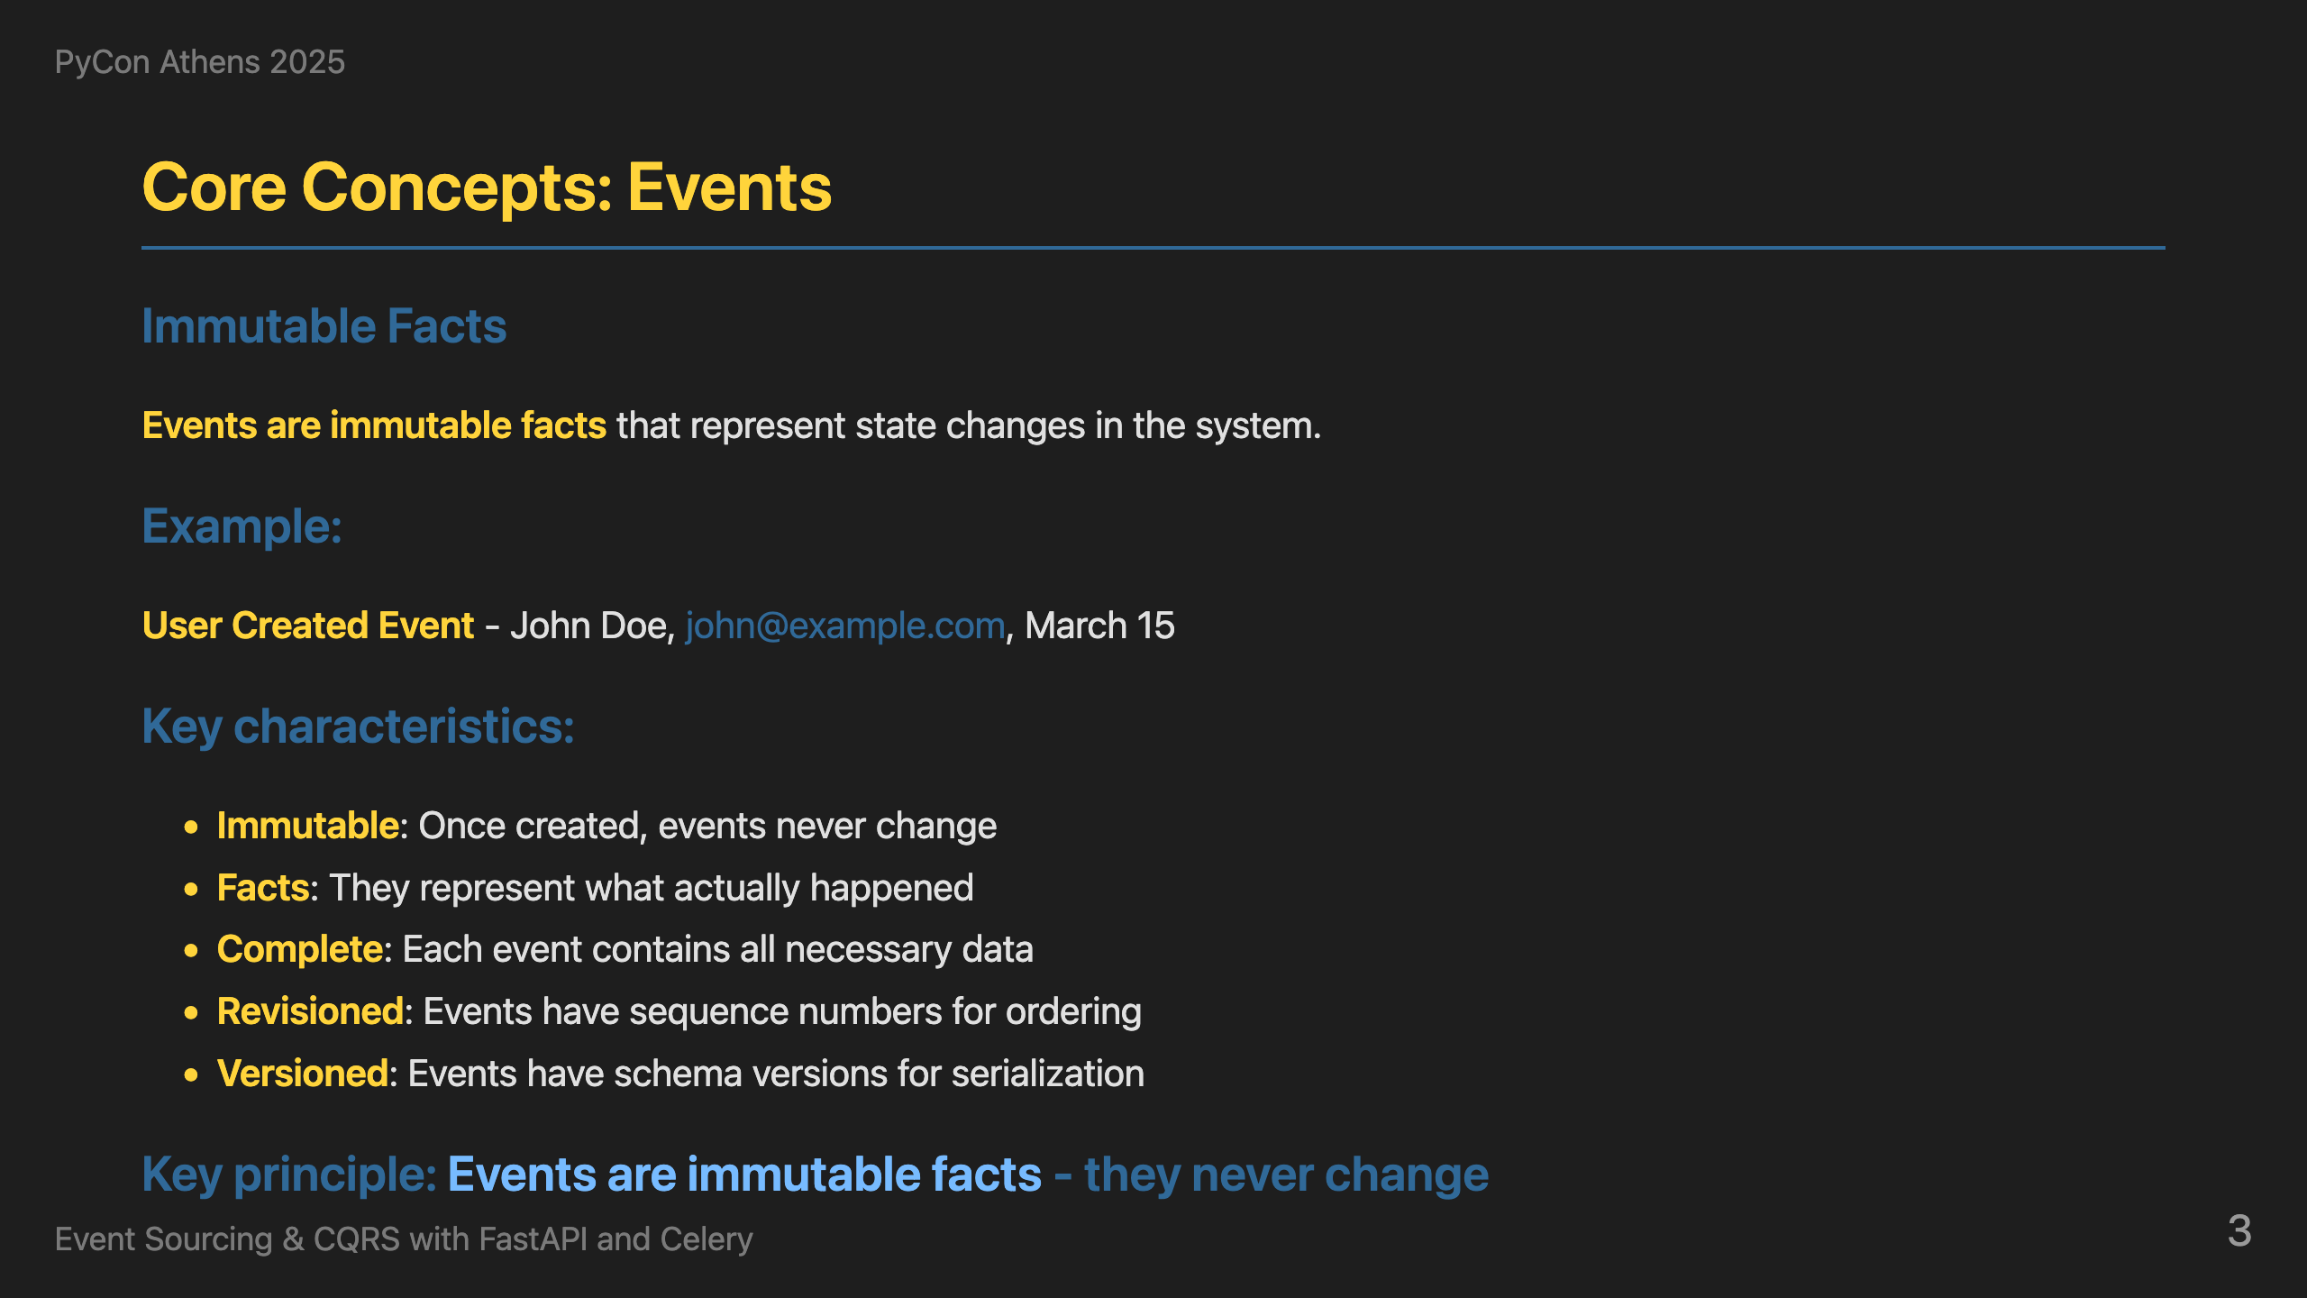
Notes:
So how do we solve the "Who deleted my user?" problem? We combine Event Sourcing with CQRS - two powerful patterns that work together perfectly. Event Sourcing means we store every change as an immutable event. Instead of deleting data forever, we record what happened. CQRS means we separate our command logic (what changes the system) from our query logic (what reads the system). Together, this gives us complete audit trails and optimized read models. Let's understand the building blocks, starting with Events. Every change in our system becomes an immutable event. Here's what a UserCreated event looks like - it has an event_id, aggregate_id, timestamp, event_type, and the actual data. The key principle is that events are immutable facts - they never change once created. This is what gives us the audit trail we need for debugging.

Slide 4
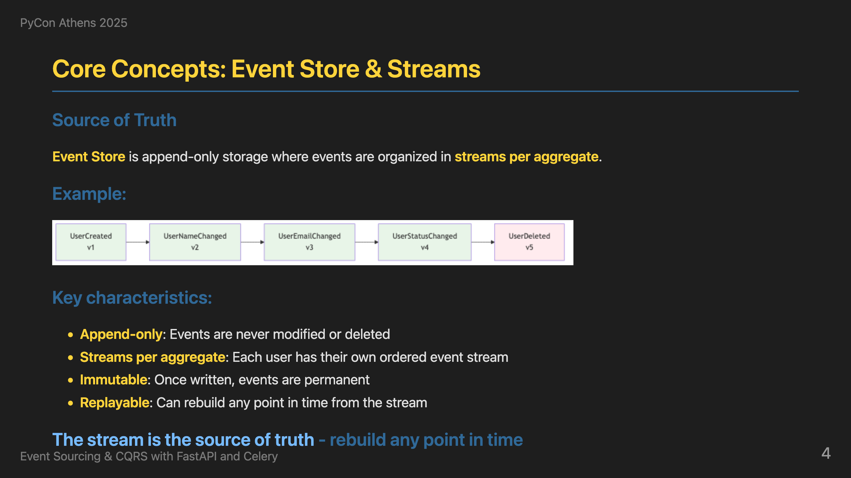
Notes:
Where do we store all these events? The Event Store is the append-only storage for all events in the system, organized in streams per aggregate. Here's a user's complete story: UserCreated, UserNameChanged, UserEmailChanged, UserStatusChanged, and finally UserDeleted. The stream is the source of truth - we can rebuild any point in time by replaying these events in order. This is how we get time travel capabilities. Operations are simple: store new events, read in order, never modify. Events are immutable - once written, they're permanent. This gives us optimistic concurrency control. Now that we understand where events are stored, let's look at how we actually create them. Commands are the entry point for all changes.

Slide 5
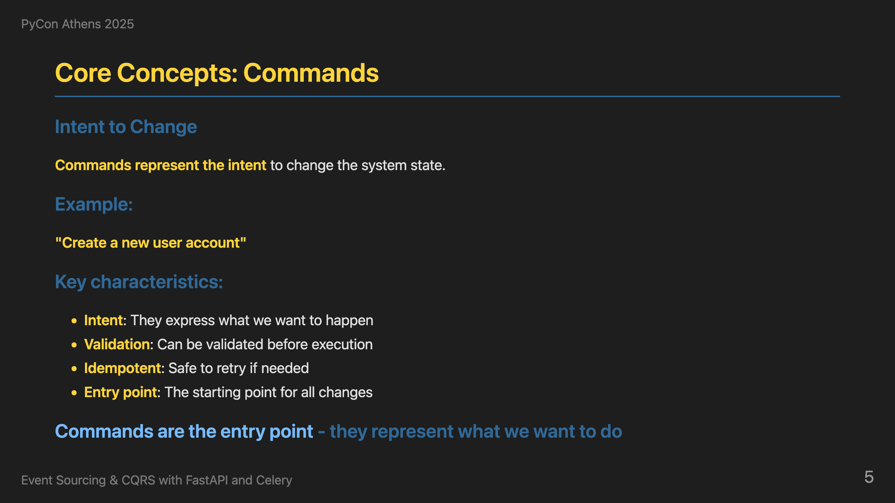
Notes:
Now, how do we actually change the system? Commands represent the intent to change the system state. They express what we want to happen - like 'Create a new user account'. Commands can be validated before execution, are idempotent for safety, and serve as the entry point for all changes. This is the command side of CQRS. Commands create events, but how do we read the data? That's where queries come in - the other side of CQRS.

Slide 6
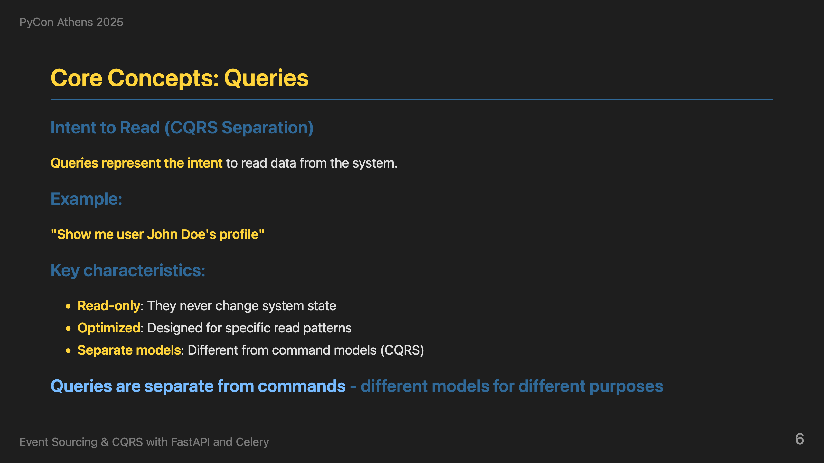
Notes:
On the other hand, queries represent the intent to read data from the system. They're read-only, optimized for specific patterns, use separate models from commands, and are designed for fast retrieval. This is the query side of CQRS - completely separate from the command side. So we have commands that create events, and queries that read data. But where does the business logic live? That's where aggregates come in - they contain the domain logic and apply business rules.

Slide 7
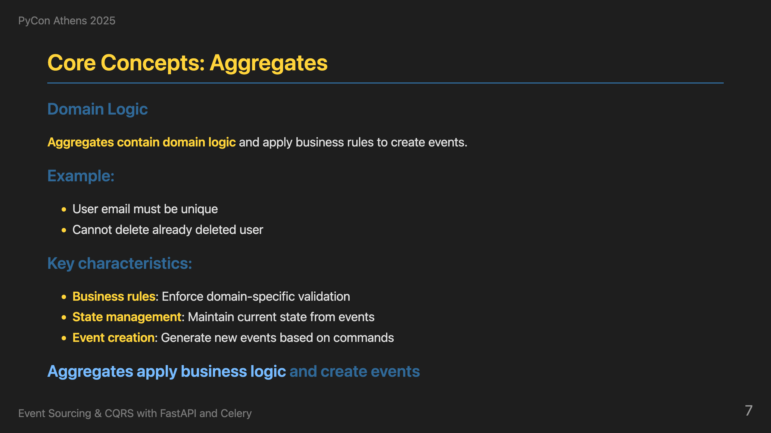
Notes:
Now, where does the business logic live? Aggregates contain domain logic and apply business rules to create events. They enforce domain-specific validation like 'User email must be unique' and 'Cannot delete already deleted user'. When rules pass, they create events. When rules fail, they return errors. This ensures business invariants are maintained.

Slide 8
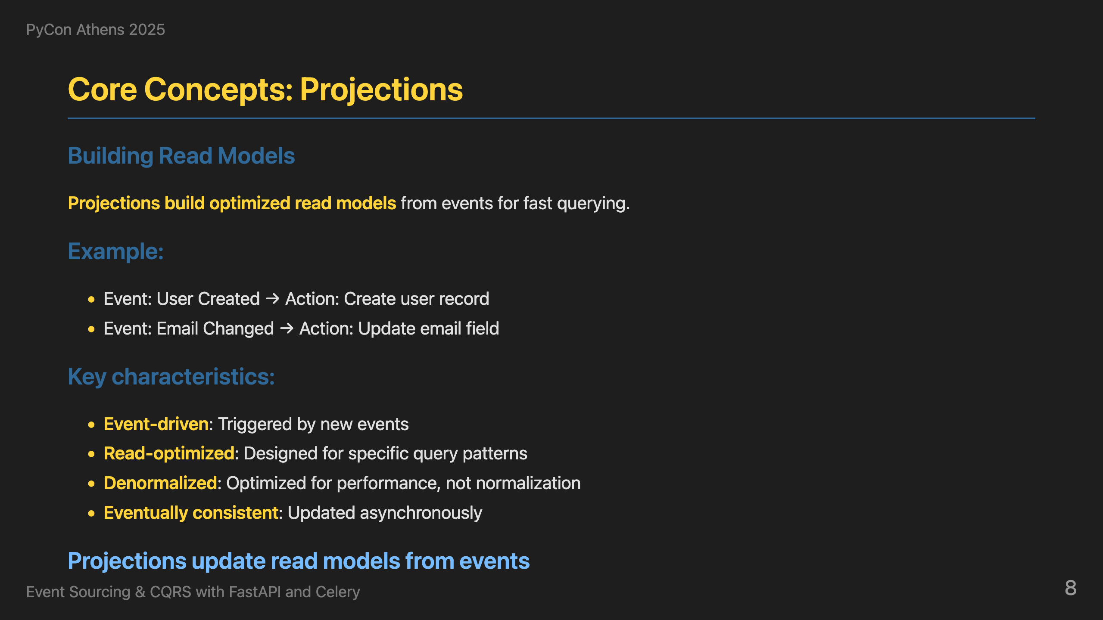
Notes:
Finally, how do we build fast read models? Projections build optimized read models from events for fast querying. When a UserCreated event happens, we create a user record. When EmailChanged happens, we update the email field. This gives us event-driven read model updates that are optimized for queries and eventually consistent.

Slide 9
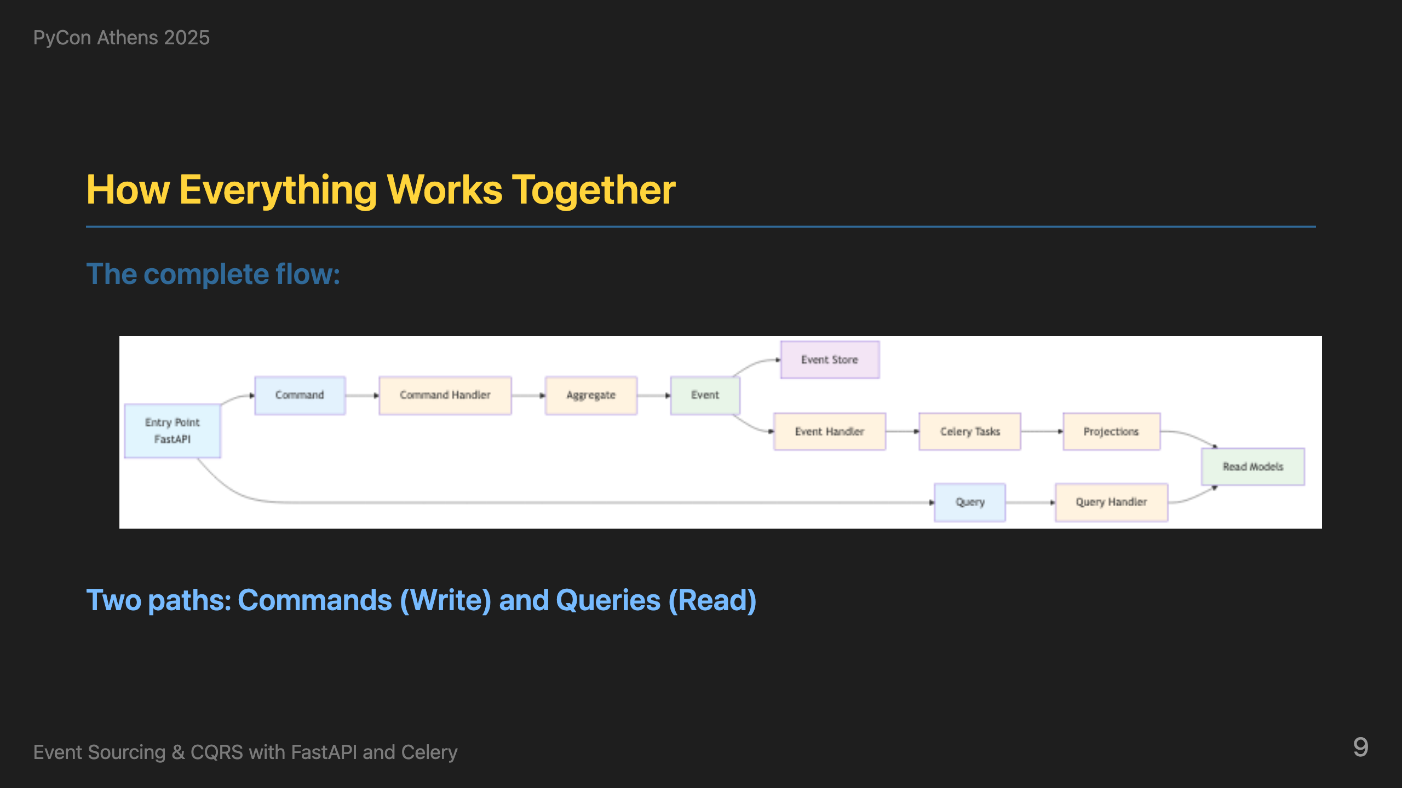
Notes:
Now that we understand all the building blocks, here's how everything connects in a real-world example. The diagram shows two distinct paths: **Command Path (Write)**: User makes an API call to change password. This goes to our FastAPI command endpoint, which creates a ChangePasswordCommand and passes it to the command handler. The command handler loads all events for this user from the event store, creates a UserAggregate, and replays all events to rebuild the current state. Then it calls the domain method change_password, which validates business rules and generates new events. These new events are stored in the event store and dispatched to the event handler. The event handler maps the event type to Celery tasks and sends them to the message queue. Celery workers pick up these tasks and call the appropriate projections. The projections update the read models with the new data. **Query Path (Read)**: When another user makes a query API call to get user data, it goes to our FastAPI query endpoint, which uses the query handler to fetch data directly from the read models - the same data that was just updated by the projections. This is CQRS in action - commands go through the full event sourcing pipeline, queries read directly from optimized read models. Same API entry point, completely different paths.

Slide 10
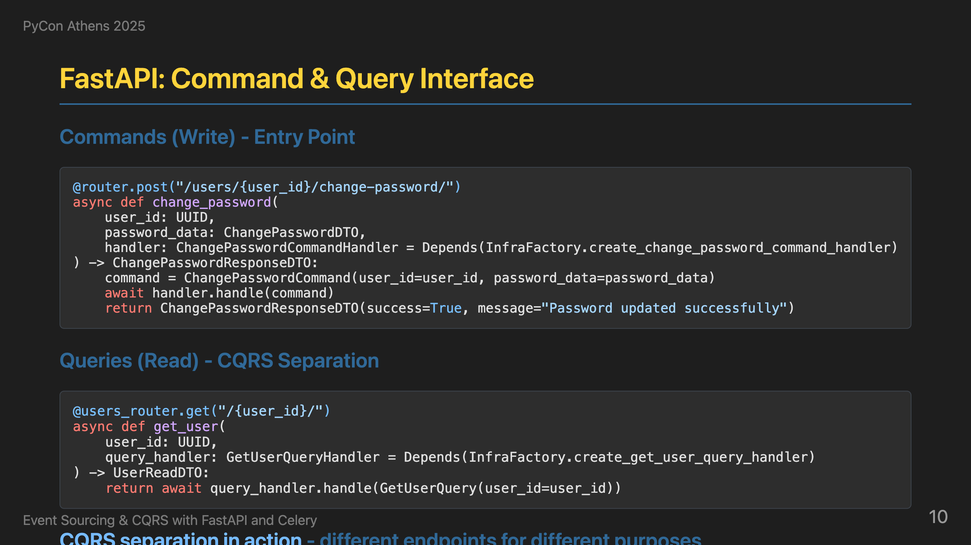
Notes:
Now let's see how the Python ecosystem implements this architecture. Here's how we implement this with FastAPI. We define our endpoints to accept user data. We create commands using Pydantic models for validation. When a request comes in, we create a CreateUserCommand, get the appropriate handler from our infrastructure factory, and process the command. Notice we return immediately - we don't wait for the event to be processed. This gives us high availability and responsiveness. For queries, we have separate endpoints that read from optimized read models. This is CQRS in action - commands write to the event store, queries read from optimized read models. The same API, different responsibilities.

Slide 11
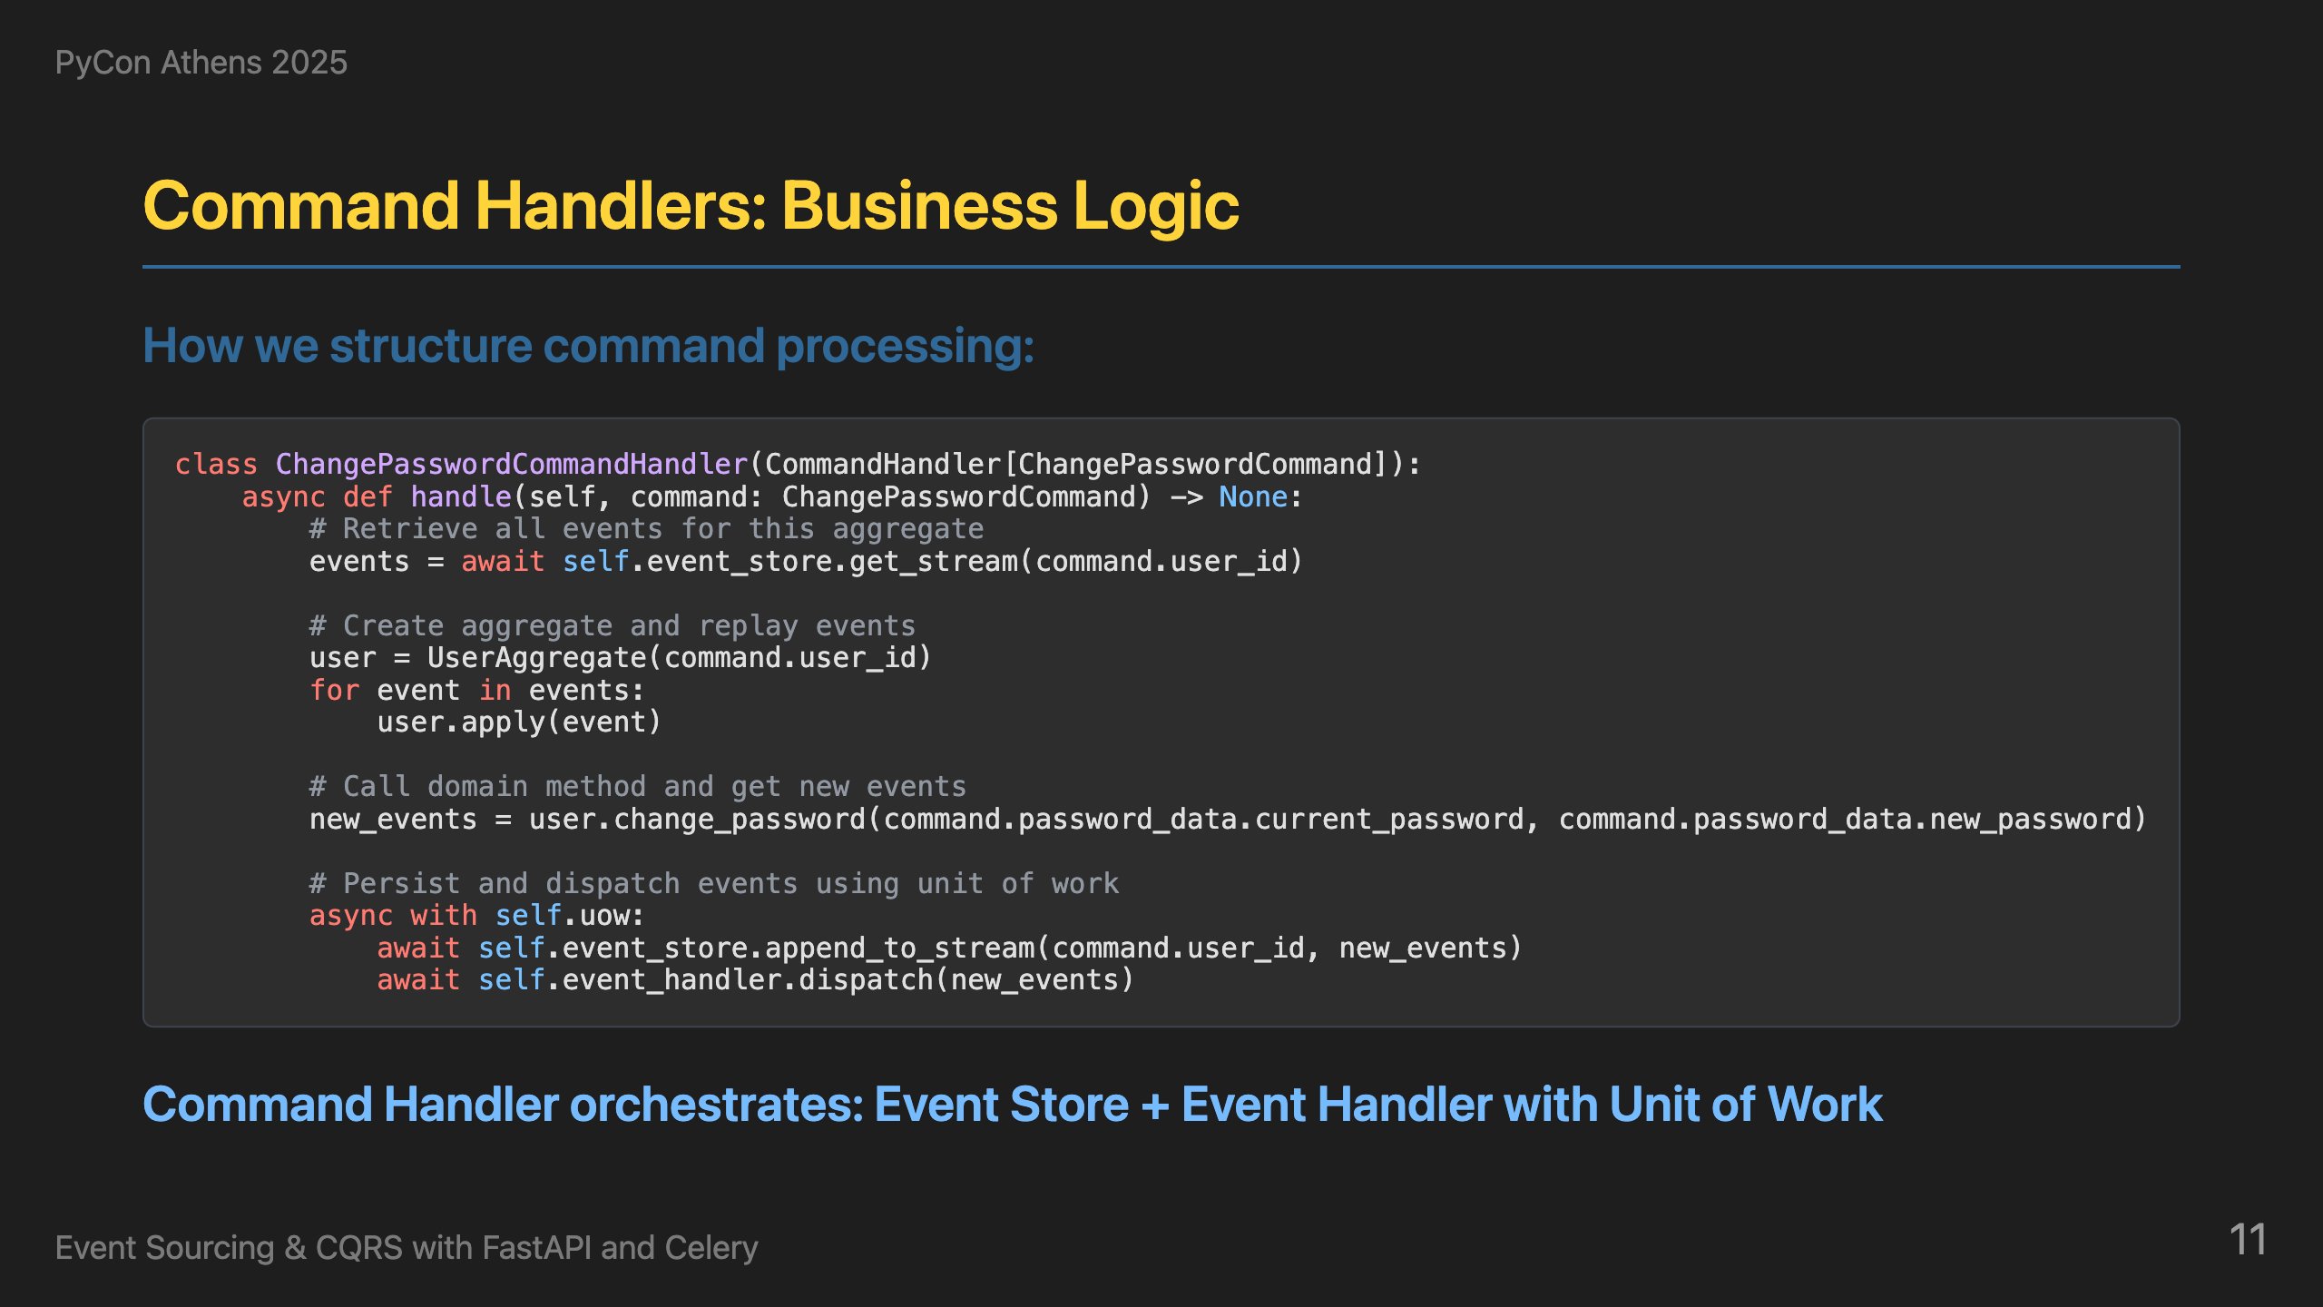
Notes:
Behind the API, command handlers are where the business logic lives. Here's our ChangePasswordCommandHandler with stream-based operations. The handle method loads the existing aggregate from the stream, reconstructs the state by applying all previous events, calls the domain method to validate and create an event, applies the event to the aggregate, appends to the stream with revision checking for concurrency control, and publishes it to the event bus. This gives us clean separation between business logic and infrastructure concerns.

Slide 12
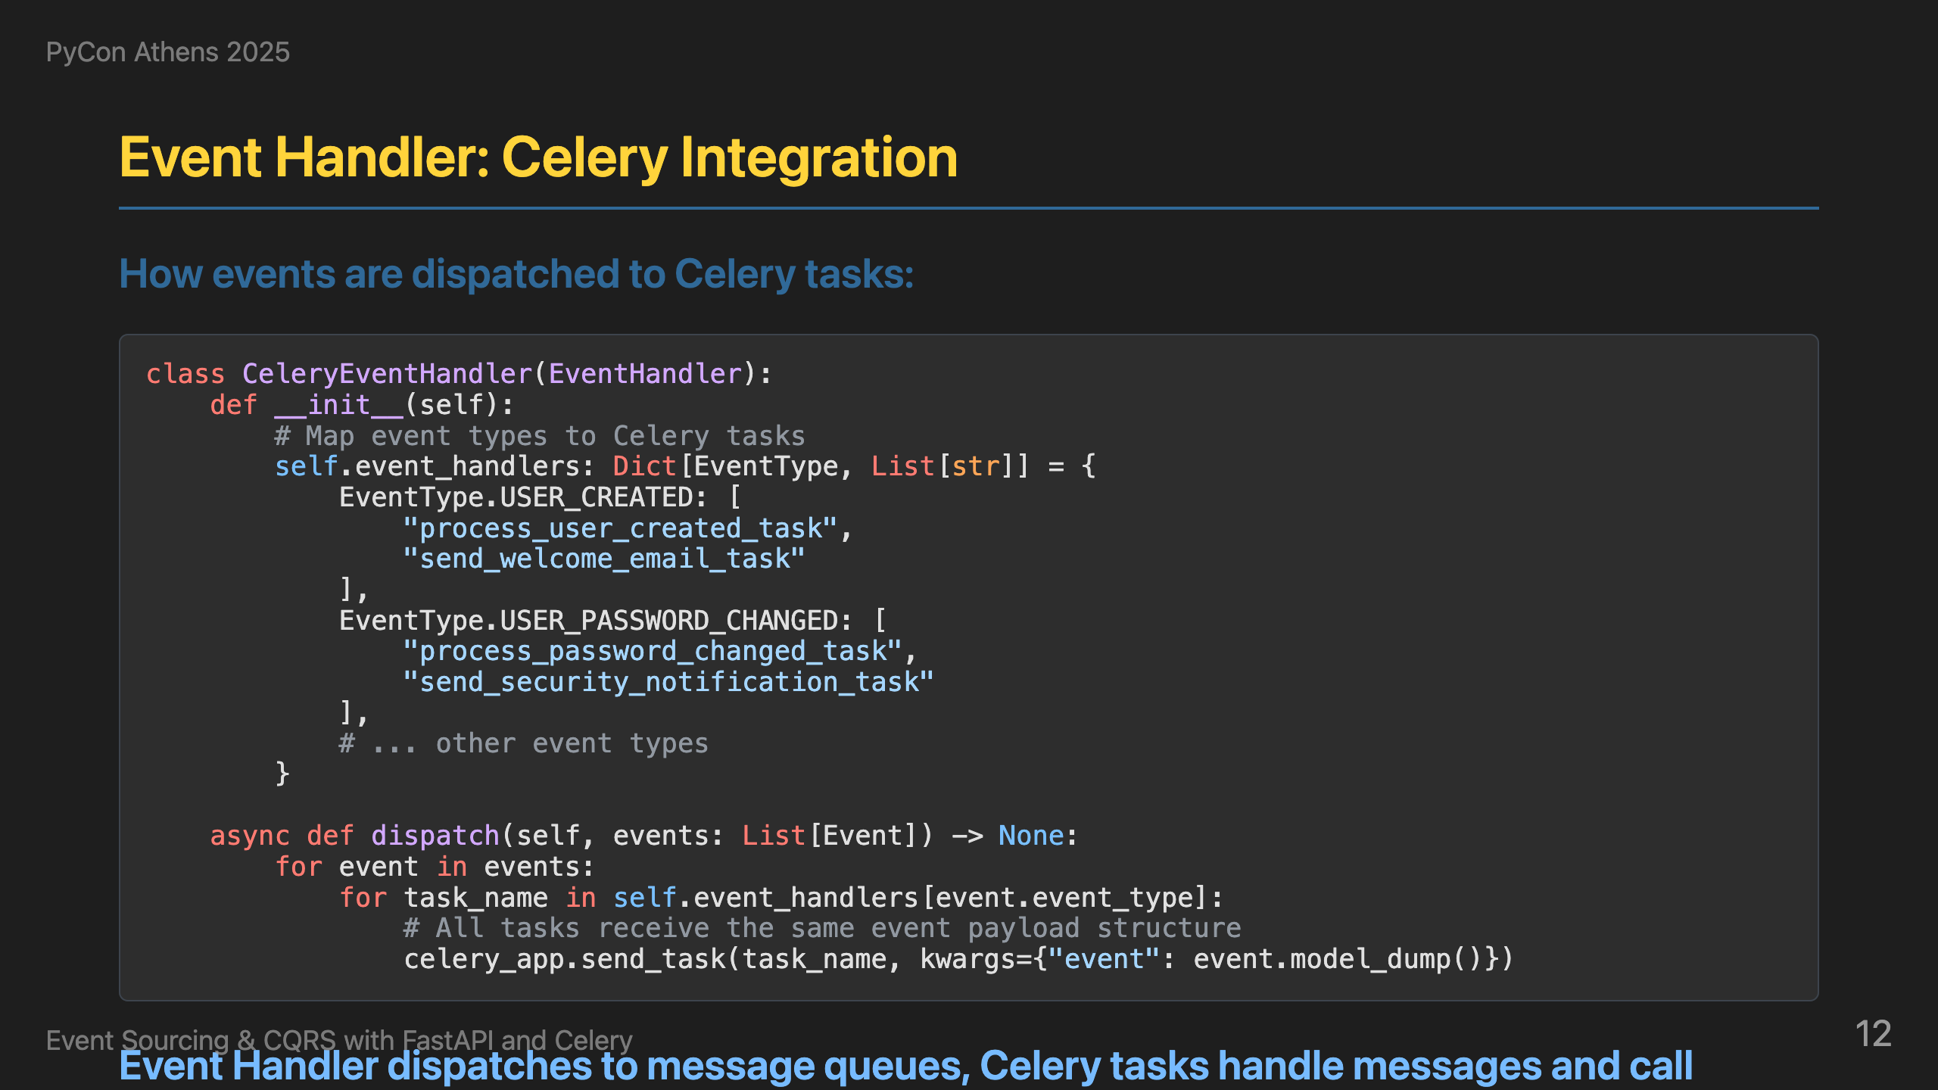
Notes:
Once events are created, the Event Handler dispatches them to message queues. Here's our CeleryEventHandler that maps event types to Celery tasks. When a USER_CREATED event comes in, it triggers process_user_created_task and send_welcome_email_task. The dispatch method sends each task to Celery with the event data. This gives us scalable, async event processing.

Slide 13
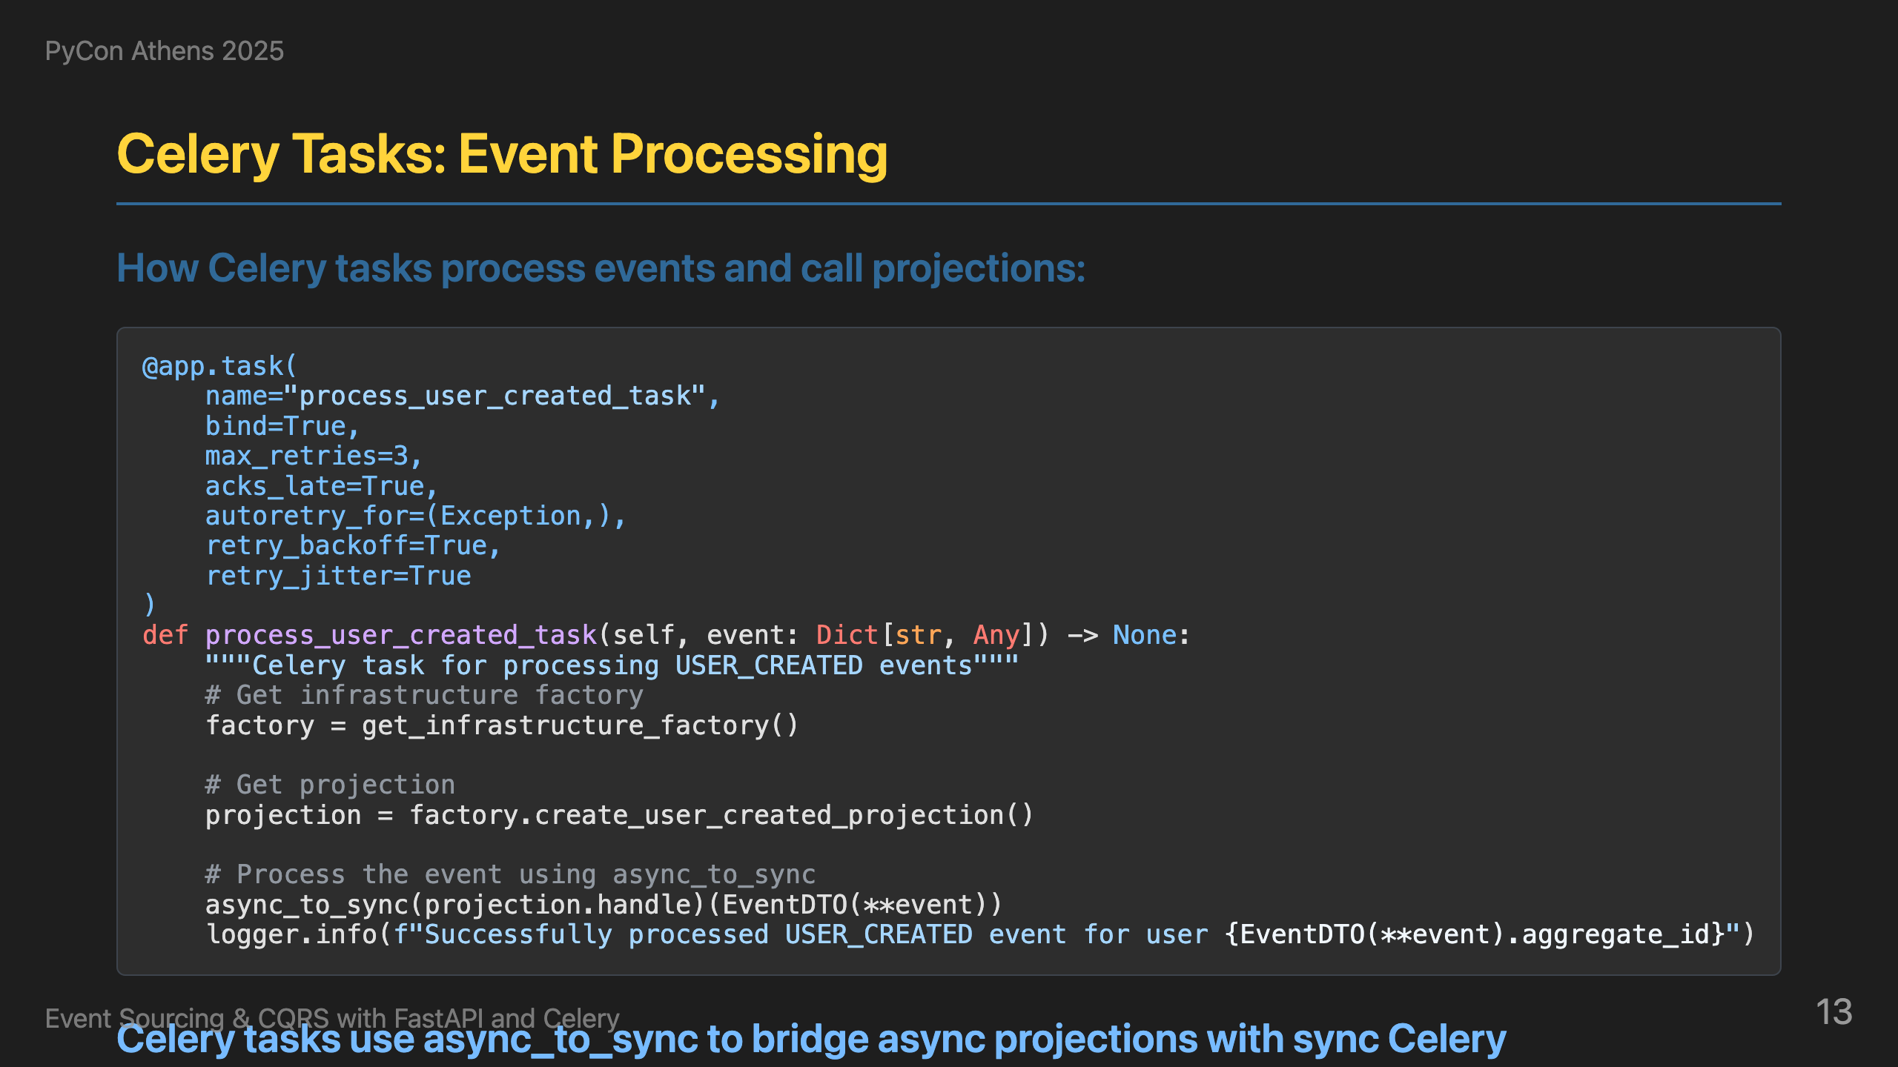
Notes:
On the receiving end, Celery tasks are wrappers that call the appropriate projection handlers. Here's how it works: we define a Celery task that receives an event, get the projection from the infrastructure factory, and use async_to_sync to convert the async projection.handle method to sync for Celery. The task is just a wrapper - the actual business logic is in the projection handlers, and async_to_sync bridges the gap between async projections and sync Celery tasks.

Slide 14
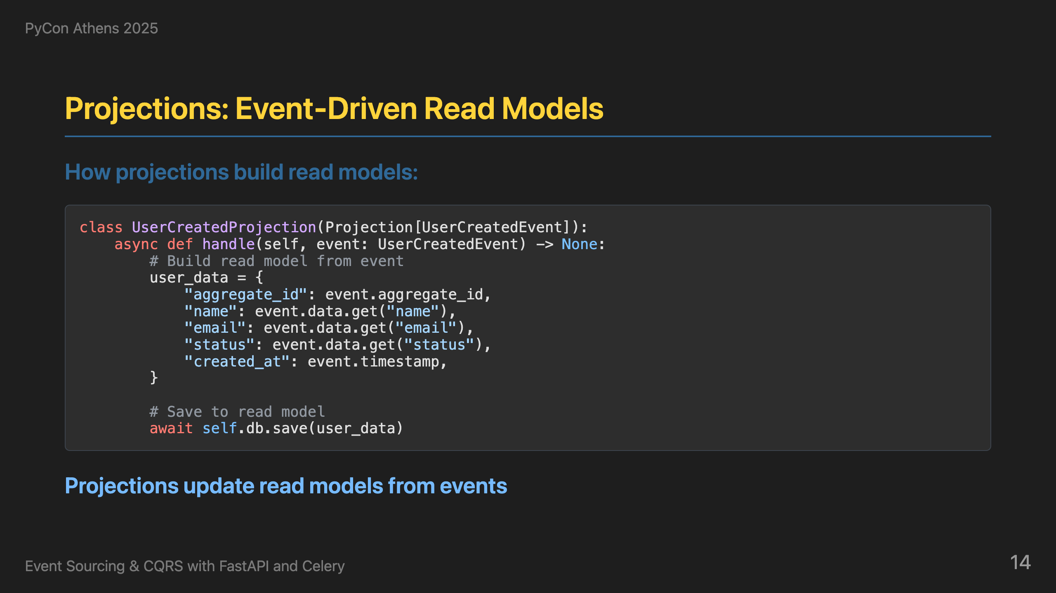
Notes:
Inside the Celery tasks, projections update read models from events. Here's our UserCreatedProjection. When a user_created event comes in, we build user data with aggregate_id, name, email, and created_at. We save this to the read model. This gives us event-driven read model updates that are optimized for queries.

Slide 15
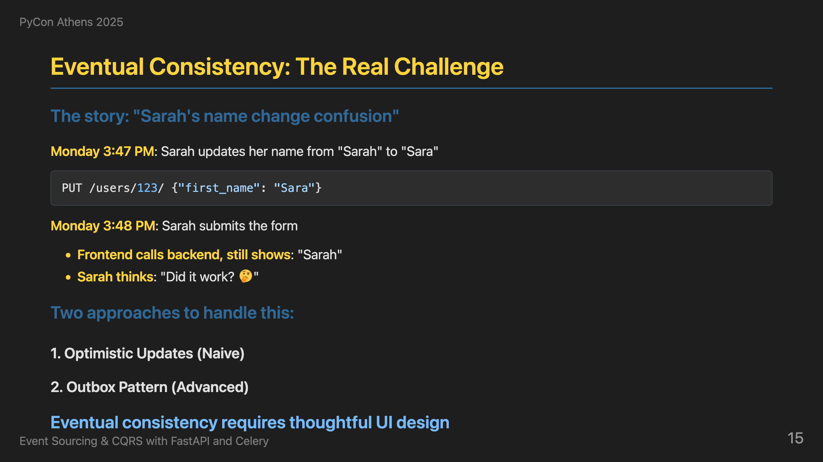
Notes:
This is a real story that happened to us. Sarah updated her name from "Sarah" to "Sara", the API returned success immediately, but when the frontend called the backend to get the updated data, it still showed "Sarah". This is the reality of eventual consistency - your API says "success" but the read model might not be updated yet. I've seen two approaches to handle this. The naive approach is optimistic updates - the frontend updates the UI immediately, but if the user refreshes or calls the backend, they might see old data. This creates confusion and support tickets. The more advanced approach is the outbox pattern - we store events in an outbox table with job status, track processing status like pending, processing, completed, or failed, and create views of unprocessed events. This gives us clear visibility into what's been processed versus what's still pending. The key insight is that eventual consistency isn't just a technical challenge - it's a UX challenge. Users expect immediate feedback, but they also expect consistency. You need to design your UI to handle this gracefully.

Slide 16
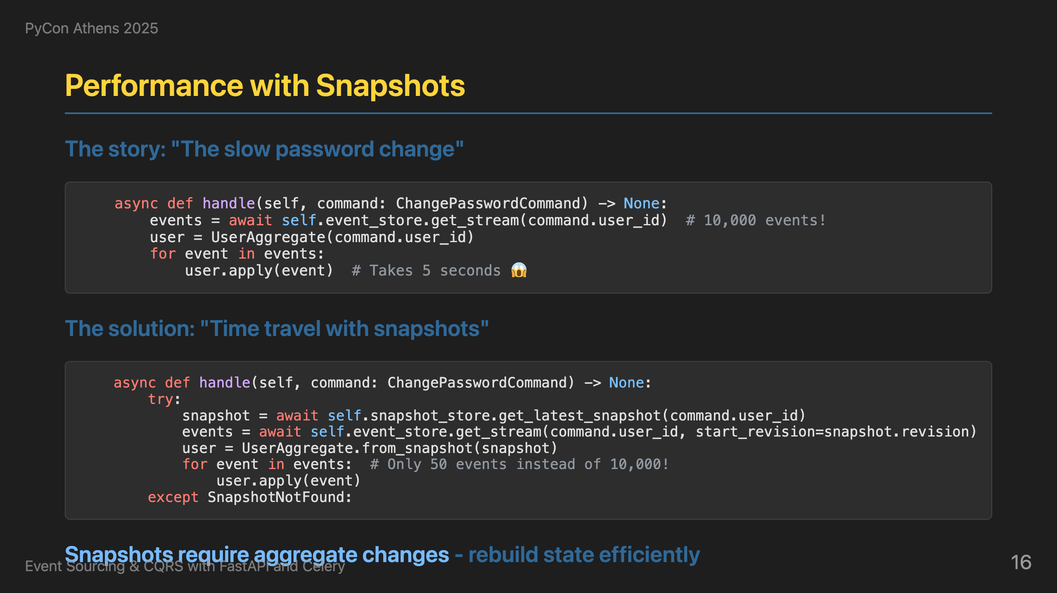
Notes:
This is a real story that happened to us. John has been using our system for 2 years and has 10,000+ events. When he tried to change his password, it took 5 seconds. He was frustrated and asked "Why is this so slow?" This is the performance challenge of event sourcing - replaying thousands of events takes time. The solution is snapshots - we save state every 1,000 events. Instead of replaying 10,000 events, we only replay the recent 50 events since the last snapshot. This reduces the password change time from 5 seconds to 0.5 seconds. We try to get the latest snapshot first, and if it exists, we rebuild the aggregate from the snapshot and apply only the recent events. If no snapshot exists, we fall back to getting all events - this handles the case where snapshots haven't been created yet. This gives us the best of both worlds - performance when snapshots exist, and correctness when they don't. The key insight is that snapshots require proper error handling in the command handlers, but the performance improvement is dramatic.

Slide 17
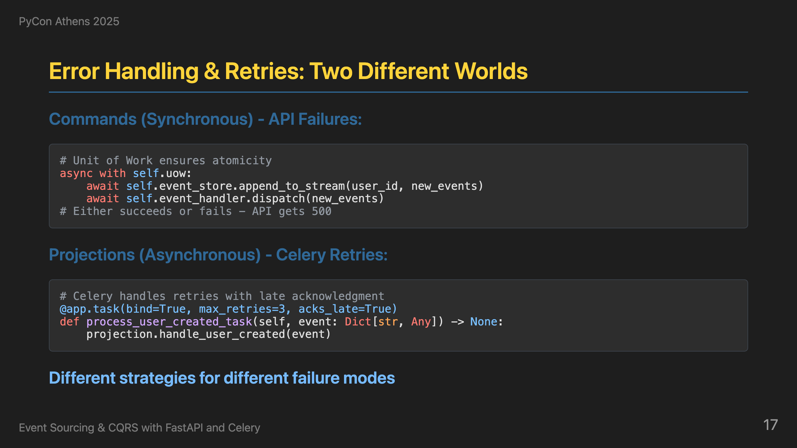
Notes:
This is a real story that happened to us. Sarah changed her password, the command succeeded and the API returned 200, but the projection failed due to a database connection timeout. When Sarah tried to log in with her new password, it failed because the read model wasn't updated. She panicked and asked "Did my password change work?" This is the reality of distributed systems - different parts can fail independently. For commands - the synchronous API calls - we use Unit of Work to ensure atomicity. Either the event is stored and dispatched, or it fails completely and the API returns a 500. There's no retry here - it's all or nothing. For projections - the asynchronous Celery tasks - we use Celery's built-in retry mechanisms with late acknowledgment. Messages are never lost, but idempotence is critical because the same message can arrive multiple times. This actually enables powerful capabilities like backfill tasks that can reprocess all events from the event store. The key insight is that you need different strategies for different failure modes - commands need immediate consistency, projections need eventual consistency with retries.

Slide 18
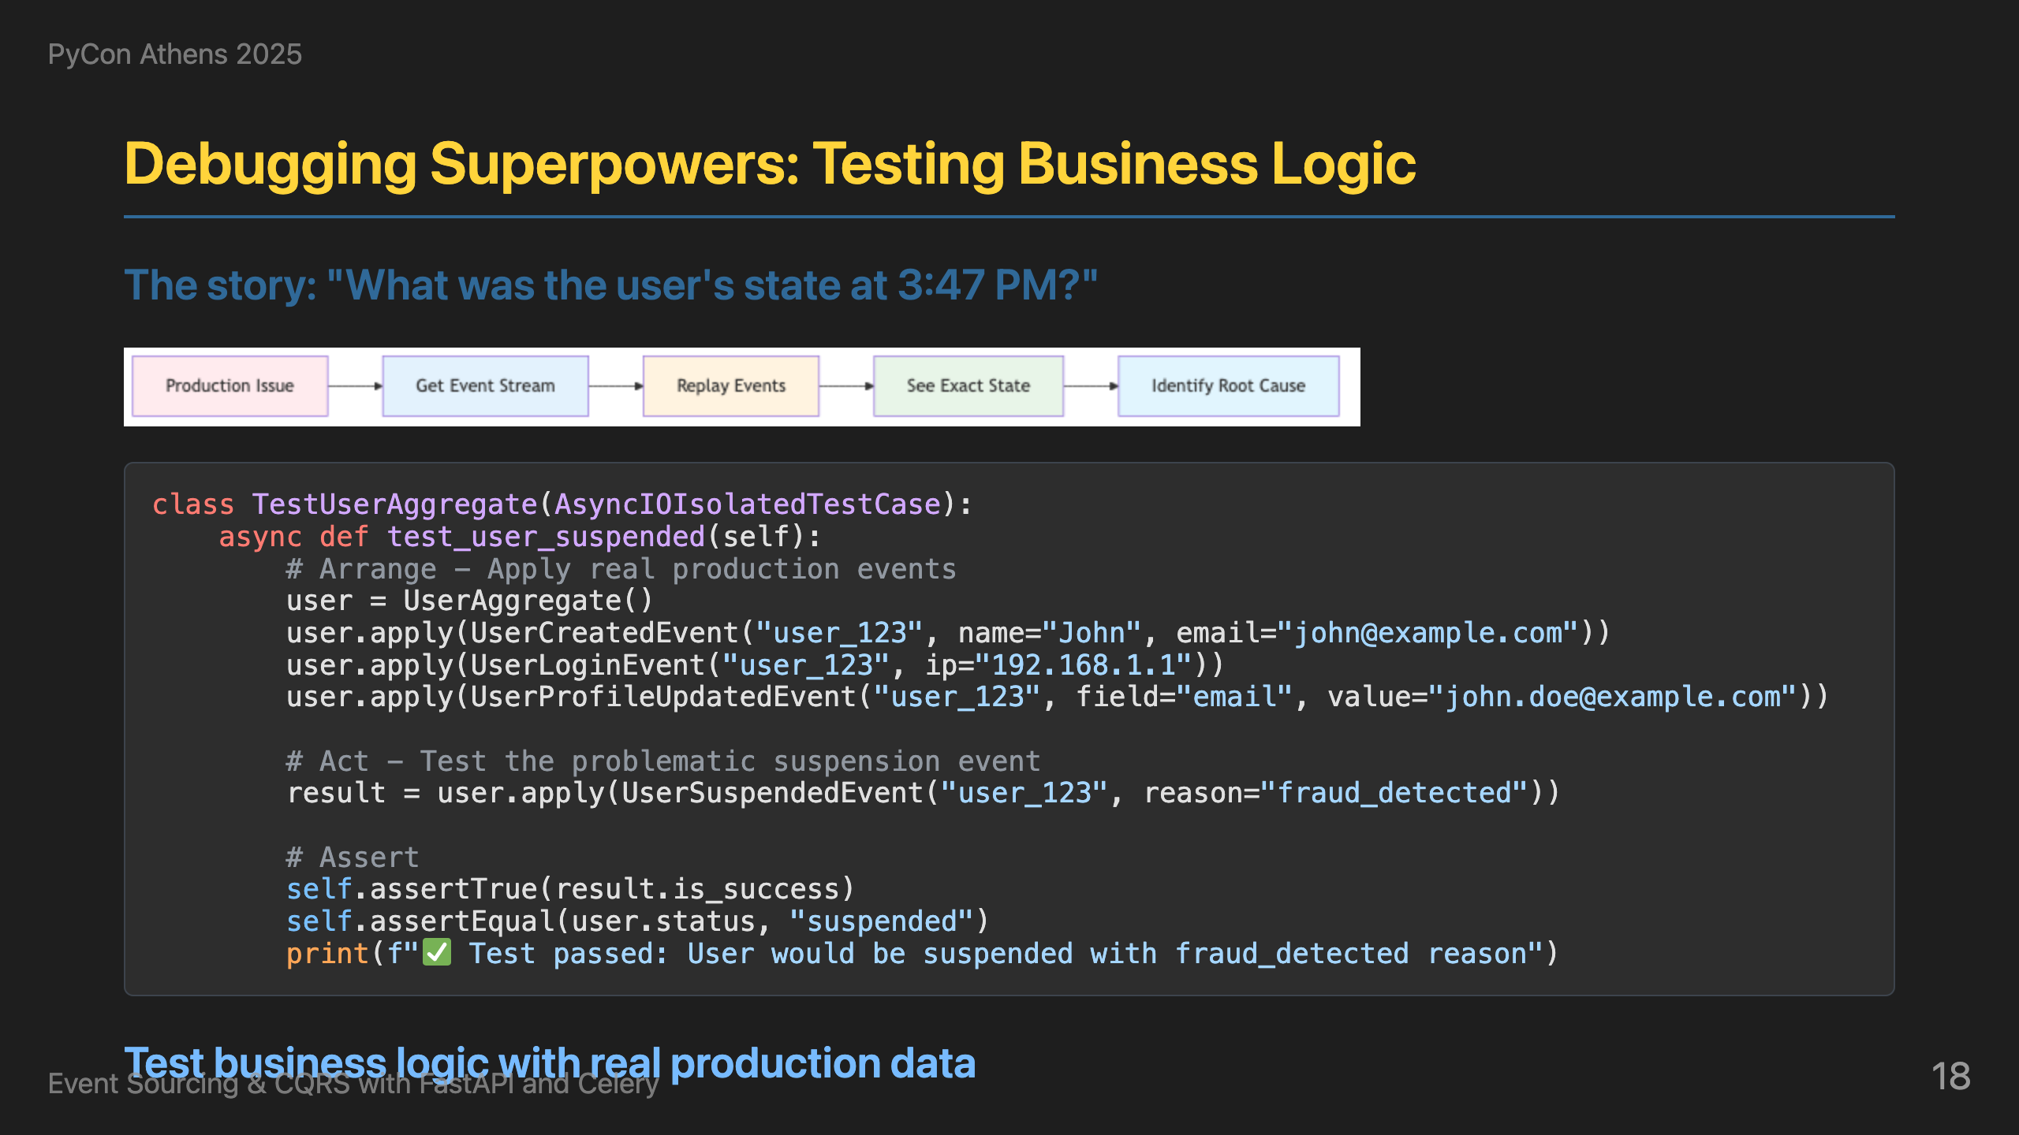
Notes:
This is a real story that happened to us. John submitted a support ticket: "Why was my account suspended yesterday at 3:47 PM? I was just logging in normally! This is affecting my work!" With traditional systems, we would have said "Sorry, we can't see what happened." But with event sourcing, we can replay exactly what happened. Instead of trying to recreate scenarios in test environments, we can rebuild the exact state at any moment in history. Here's how it works: we get all events before a specific incident time, rebuild the aggregate state at that exact moment, and then apply the problematic event that caused the issue - like a UserSuspendedEvent. This lets us see exactly what the business rules would do when that event is applied, and understand why certain actions were allowed or blocked. This gives us the ability to debug issues that happened hours or days ago, and test business logic against real production data at any point in time. This is debugging and testing superpowers combined - we can answer "What was the user's state at 3:47 PM?" with complete certainty.

Slide 19
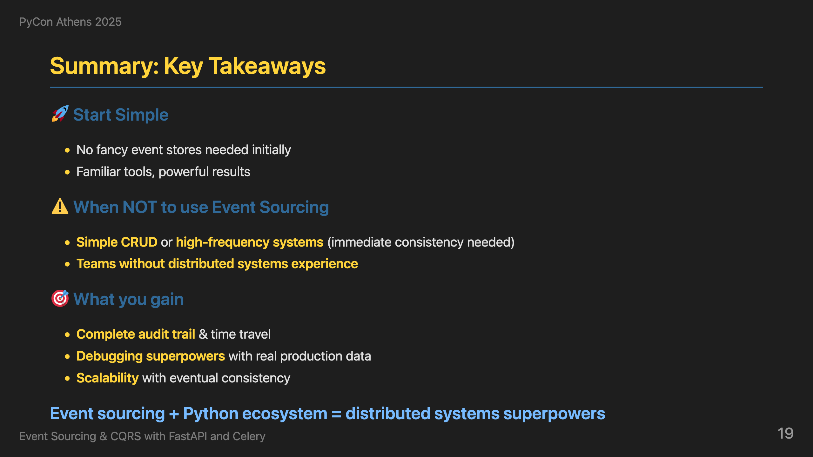
Notes:
Let me end with some practical advice. Start simple - you don't need fancy technology from day one. PostgreSQL as your event store and read database is sufficient for most cases. SQS as your event bus works great for most applications. You don't need Kurrent for event store or Elasticsearch and MongoDB for read models initially. This architecture can be easily adopted with familiar tools. When NOT to use event sourcing? Simple CRUD with basic audit needs - traditional logging suffices. High-frequency trading systems need immediate consistency. Teams without distributed systems experience will struggle with the learning curve. What you gain: complete audit trail, time travel capabilities, debugging superpowers with real production data, and scalability with eventual consistency patterns. The Python ecosystem with FastAPI and Celery is more than capable of solving even the most complex distributed systems challenges. This combination gives you the tools to build systems that can explain themselves.

Slide 20
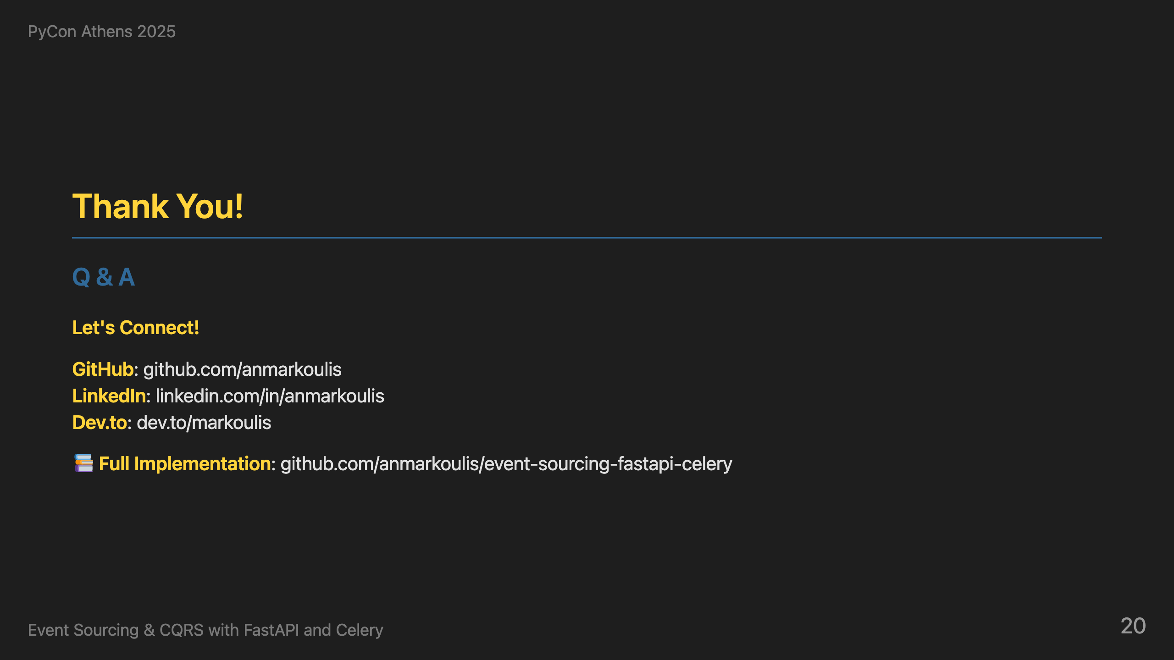
Notes:
Thank you all for your attention. I hope I've convinced you that raw events are worth loving. I've shared the complete implementation on GitHub - you can see all the patterns we discussed in action: the command handlers, event handlers, projections, and the full FastAPI + Celery integration. Feel free to explore the code, run it locally, and adapt it to your own projects. I'm happy to take questions and discuss any aspect of event sourcing, CQRS, or the Python ecosystem. Let's have a great discussion!

